Slide 1
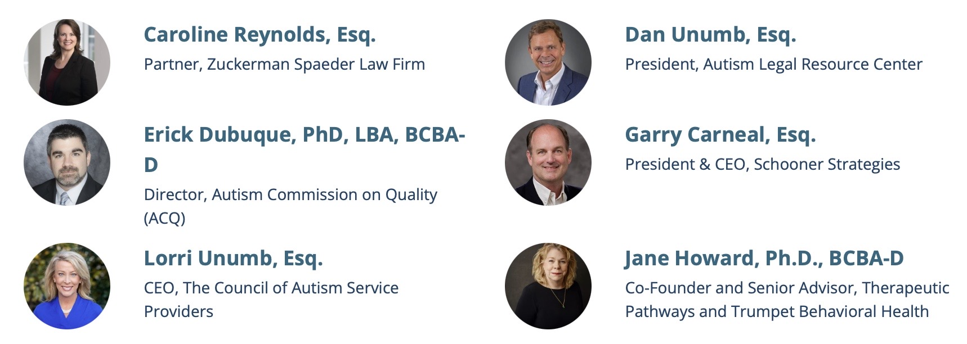
The Importance and Legal Significance of Generally Accepted Standards of Care in ABA

Slide 2
What Are Generally Accepted Standards of Care?

Slide 3


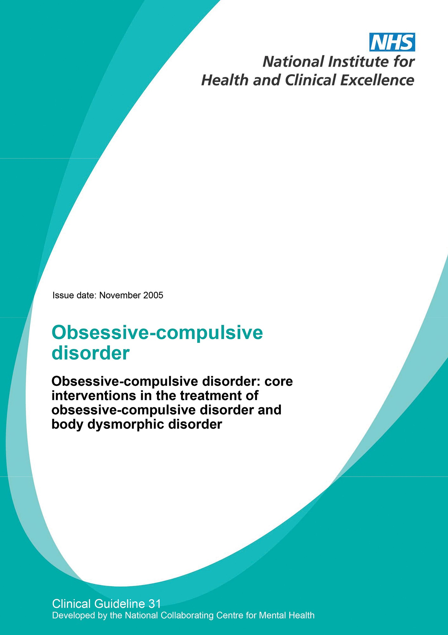
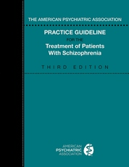
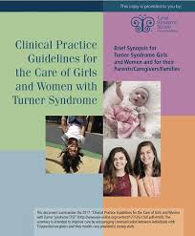
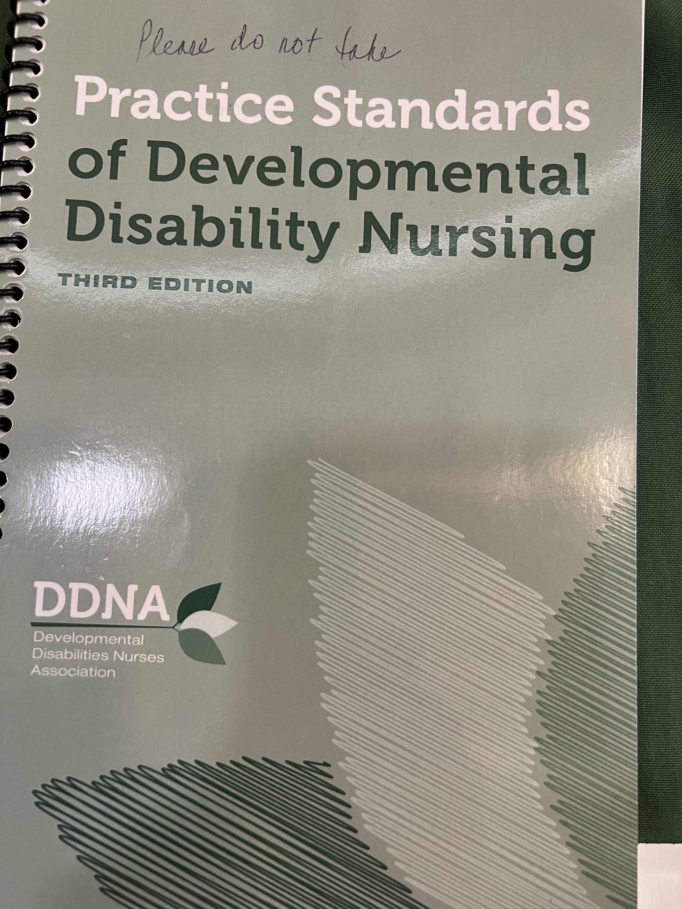

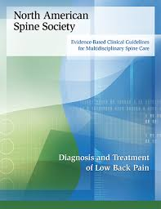
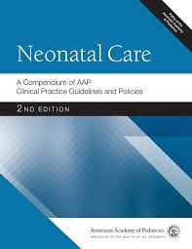
What are generally accepted standards of care?

Slide 4
When did our field – ABA for autism – generally agree upon or accept standards for practicing ABA with individuals with autism?

Slide 5
When did our field articulate those standards?

Slide 6
Why did the BACB decide to put together a workgroup to develop ABA for ASD Practice Guidelines?

Slide 7
The Importance and
Legal Significance of Clinical
Standards
Laws Requiring Coverage
California Senate Bill 855
California DOI Regulations
Wit v. United Healthcare

Slide 8
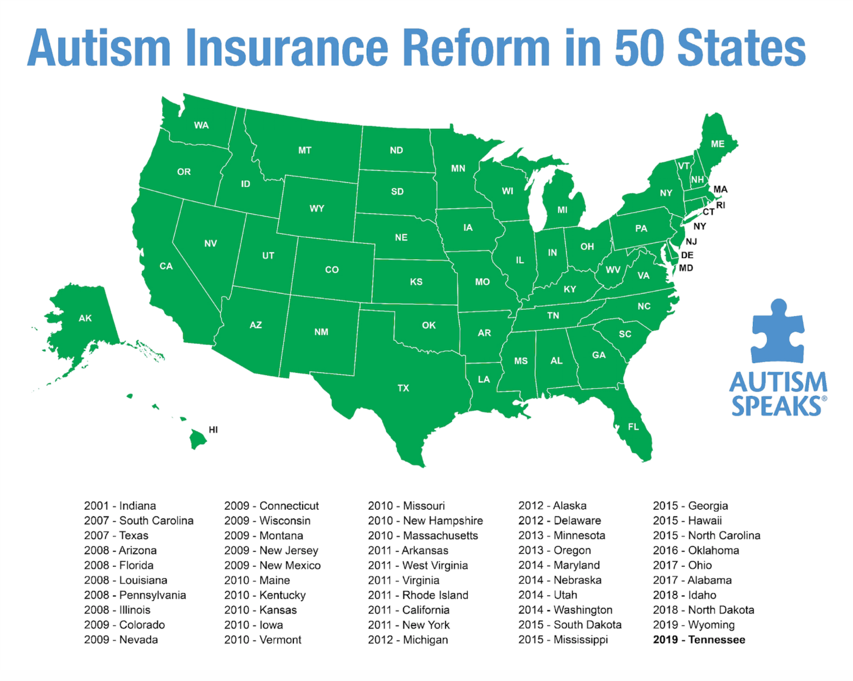

Slide 9
When did everyone start following the ABA for ASD Practice Guidelines?

Slide 10
The Importance and
Legal Significance of Clinical
Standards
Laws Requiring Coverage
California Senate Bill 855
California DOI Regulations
Wit v. United Healthcare

Slide 11

Wit v. United Behavioral Health
UBH owed duty to administer plans solely in the interest of the participants. Promised to cover all care in accordance with generally accepted standards.
Violated obligations by using guidelines more restrictive than generally accepted standards and prioritizing cost savings over members interests.
Court noted multiple sources for determining generally accepted standards of care, including:
  peer-reviewed studies;
  consensus guidelines from professional organizations (ex., American Association of Community Psychiatrists, American Academy of Child and Adolescent Psychiatry, APA)
  guidelines and materials distributed by government agencies (ex., CMS).

Slide 12
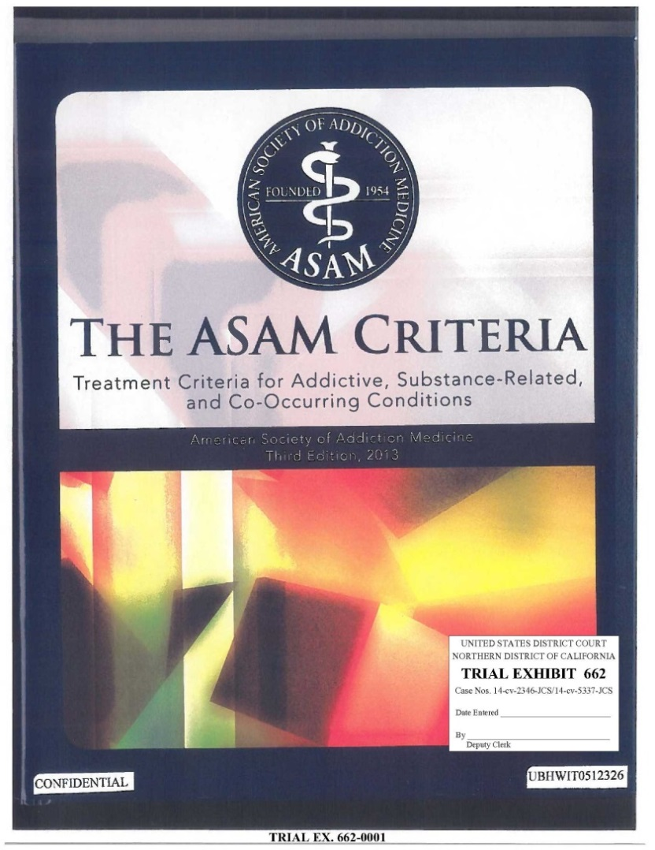
District Court’s Liability Ruling
“The ASAM Criteria are the most widely accepted articulation of the generally accepted standards of care for how to conduct a comprehensive multidimensional assessment of a patient with substance related disorder, translate that into patient treatment needs and match those needs to the appropriate level of care.”

Slide 13
The Importance and
Legal Significance of Clinical
Standards
Laws Requiring Coverage
California Senate Bill 855
California DOI Regulations
Wit v. United Healthcare

Slide 14
SB 855 California
1374.721. (a) A health care service plan . . .shall base any medical necessity determination or the utilization review criteria . . .on current generally accepted standards of mental health and substance use disorder care.
(b) In conducting utilization review . . . shall apply the criteria and guidelines set forth in the most recent versions of treatment criteria developed by the nonprofit professional association for the relevant clinical specialty.
(c) In conducting utilization review . . . shall not apply different, additional, conflicting, or more restrictive utilization review criteria than the criteria and guidelines set forth in those sources.

Slide 15
Ramstad Model Legislation – The Kennedy Forum
https://www.thekennedyforum.org/app/uploads/2021/05/Ramstad-Model-Legislation-May-2021.pdf
Jim Ramstad Model State Legislation to Advance Mental Health and Addiction Equity By Requiring Compliance with Generally Accepted Standards of Care
Illinois
Oregon
Georgia
New Mexico

Slide 16
The Importance and
Legal Significance of Clinical
Standards
Laws Requiring Coverage
California Senate Bill 855
California DOI Regulations
Wit v. United Healthcare

Slide 17
STATE OF CALIFORNIA DEPARTMENT OF INSURANCE
MENTAL HEALTH AND SUBSTANCE USE DISORDER PARITY IN HEALTH INSURANCE
Adopt: Section 2562.02. Required Clinical Criteria for Mental Health Conditions and Substance Use Disorders.
(a) An insurer shall base any medical necessity determination, and the utilization review criteria that the insurer, or any entity acting on the insurer’s behalf, applies to determine the medical necessity of health care services and benefits for the diagnosis, prevention, and treatment of mental health conditions and substance use disorders, on current generally accepted standards of mental health and substance use disorder care.
(b) In conducting utilization review of a health care benefit for a mental health condition or substance use disorder in children, adolescents, or adults, an insurer shall:
  (1) Apply the clinical criteria and guidelines set forth in the most recent versions of treatment criteria developed by nonprofit professional associations for the relevant clinical specialty.
  (2) Not apply different, additional, conflicting, or more restrictive utilization review criteria than the clinical criteria and guidelines set forth in the most recent versions of treatment criteria developed by nonprofit professional associations for the relevant clinical specialty.
(c) (1) An insurer shall apply the clinical criteria and guidelines set forth in the most recent versions of treatment criteria developed by nonprofit professional associations for the relevant clinical specialty, including recommendations based on consensus expert opinion, whenever their application would determine the medical necessity of a health care benefit for a mental health condition or substance use disorder that is under consideration in utilization review. Subject to subdivisions (c)(2) and (c)(3) of this section, clinical criteria developed by the following nonprofit professional associations, and any other nonprofit professional associations that are not specified in this subdivision, shall be used exclusively to make utilization review coverage determinations that are within the scope of the criteria:
(A) American Academy of Child and Adolescent Psychiatry.
(B) American Academy of Family Physicians.
(C) American Academy of Neurology.
(D) American Academy of Pediatrics.
(E) American Academy of Sleep Medicine.
(F) American Association for Community Psychiatry.
(G) American College of Physicians.
(H) American Medical Association.
(I) American Psychiatric Association.
(J) American Psychological Association.
(K) American Society of Addiction Medicine.
(L) Canadian Network for Mood and Anxiety Treatments.
(M) Council of Autism Service Providers.

Slide 18
Standards Produced by Nonprofits
 | Clinical | Organizational | Accreditation
Document | Applied Behavior Analysis Treatment of Autism Spectrum Disorder: Practice Guidelines for Healthcare Funders and Managers (2d ed. CASP) | CASP Organizational Guidelines | Autism Commission on Quality (ACQ) Applied Behavior Analysis Standards
What/Why | Agreed-upon standards for treatment among clinicians that are maintained and updated by non-profit associations | -Develop & promote best practices for organizations -Assist organizations in identifying infrastructure to support sustainable, high-quality therapy -Develop benchmarks for industry | Articulate the standards by which organizations seeking accreditation will be measured
Other Relevant Resources | Clarifications Regarding Applied Behavior Analysis Treatment of Autism Spectrum Disorder: Practice Guidelines for Healthcare Funders and Managers (2nd ed.) – APBA & BACB Model Coverage Policy (ABA Coding Coalition) CPT Assistant (AMA) Practice Parameters for Telehealth-Implementation of ABA (2d ed. 2022 CASP)

Slide 19
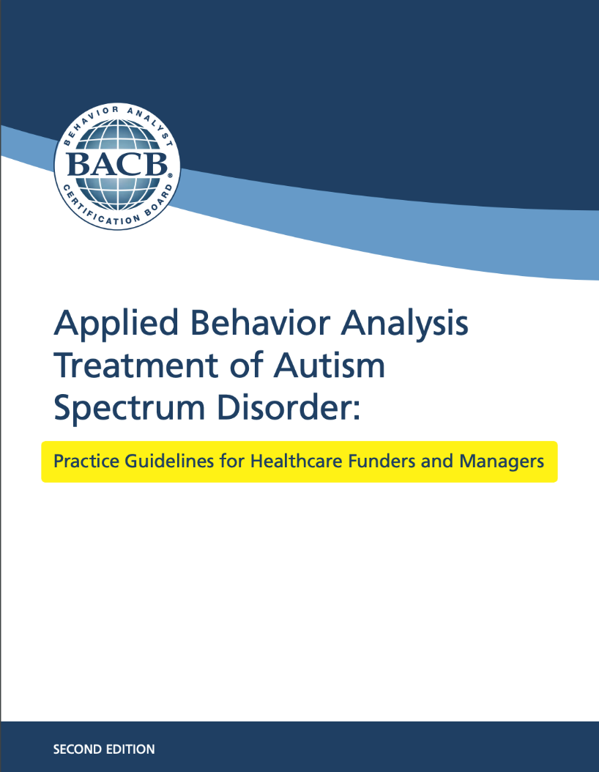
Notes:
And CASP increasingly play a large role in the work we do, as the entity that promulgates standards for the ABA field. CASP not only houses the ABA Practice Guidelines

Slide 20
Standards Produced by Nonprofits
 | Clinical | Organizational | Accreditation
Document | Applied Behavior Analysis Treatment of Autism Spectrum Disorder: Practice Guidelines for Healthcare Funders and Managers (2d ed. CASP) | CASP Organizational Guidelines | Autism Commission on Quality (ACQ) Applied Behavior Analysis Standards
What/Why | Agreed-upon standards for treatment among clinicians that are maintained and updated by non-profit associations | -Develop & promote best practices for organizations -Assist organizations in identifying infrastructure to support sustainable, high-quality therapy -Develop benchmarks for industry | Articulate the standards by which organizations seeking accreditation will be measured
Other Relevant Resources | Clarifications Regarding Applied Behavior Analysis Treatment of Autism Spectrum Disorder: Practice Guidelines for Healthcare Funders and Managers (2nd ed.) – APBA & BACB Model Coverage Policy (ABA Coding Coalition) CPT Assistant (AMA) Practice Parameters for Telehealth-Implementation of ABA (2d ed. 2022 CASP)

Slide 21
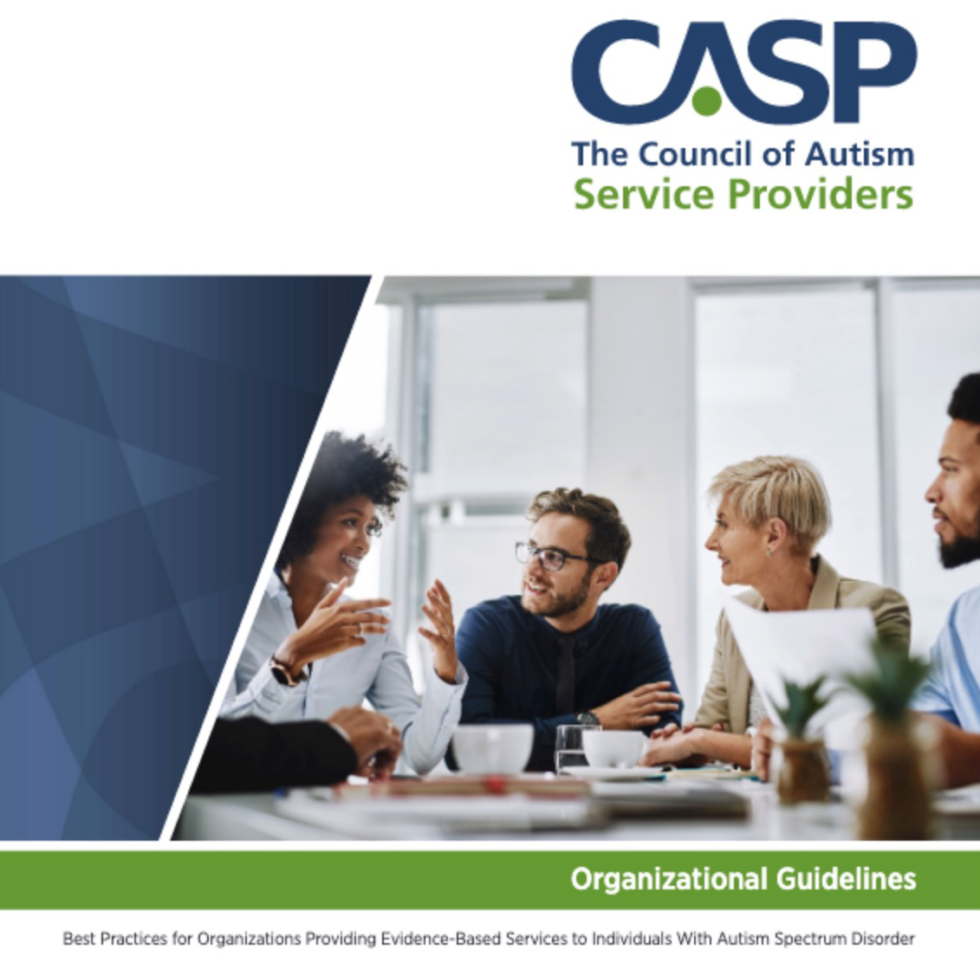

Slide 22












































Slide 23
Standards Produced by Nonprofits
 | Clinical | Organizational | Accreditation
Document | Applied Behavior Analysis Treatment of Autism Spectrum Disorder: Practice Guidelines for Healthcare Funders and Managers (2d ed. CASP) | CASP Organizational Guidelines | Autism Commission on Quality (ACQ) Applied Behavior Analysis Standards
What/Why | Agreed-upon standards for treatment among clinicians that are maintained and updated by non-profit associations | -Develop & promote best practices for organizations -Assist organizations in identifying infrastructure to support sustainable, high-quality therapy -Develop benchmarks for industry | Articulate the standards by which organizations seeking accreditation will be measured
Other Relevant Resources | Clarifications Regarding Applied Behavior Analysis Treatment of Autism Spectrum Disorder: Practice Guidelines for Healthcare Funders and Managers (2nd ed.) – APBA & BACB Model Coverage Policy (ABA Coding Coalition) CPT Assistant (AMA) Practice Parameters for Telehealth-Implementation of ABA (2d ed. 2022 CASP)

Slide 24
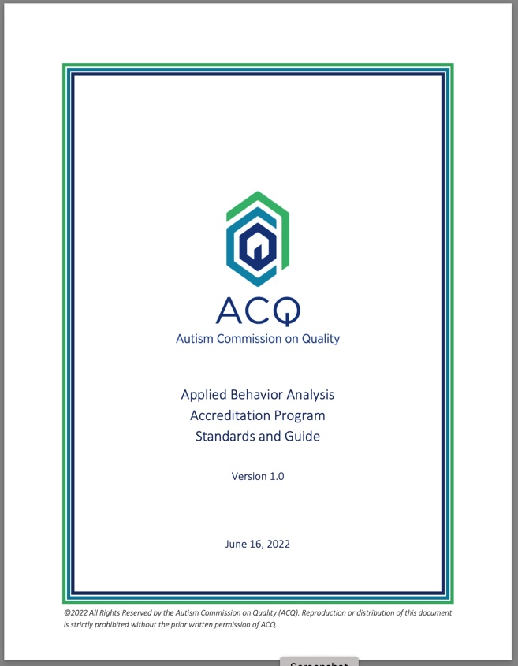

Slide 25
Standards Produced by Nonprofits
 | Clinical | Organizational | Accreditation
Document | Applied Behavior Analysis Treatment of Autism Spectrum Disorder: Practice Guidelines for Healthcare Funders and Managers (2d ed. CASP) | CASP Organizational Guidelines | Autism Commission on Quality (ACQ) Applied Behavior Analysis Standards
What/Why | Agreed-upon standards for treatment among clinicians that are maintained and updated by non-profit associations | -Develop & promote best practices for organizations -Assist organizations in identifying infrastructure to support sustainable, high-quality therapy -Develop benchmarks for industry | Articulate the standards by which organizations seeking accreditation will be measured
Other Relevant Resources | Clarifications Regarding Applied Behavior Analysis Treatment of Autism Spectrum Disorder: Practice Guidelines for Healthcare Funders and Managers (2nd ed.) – APBA & BACB Model Coverage Policy (ABA Coding Coalition) CPT Assistant (AMA) Practice Parameters for Telehealth-Implementation of ABA (2d ed. 2022 CASP)

Slide 26
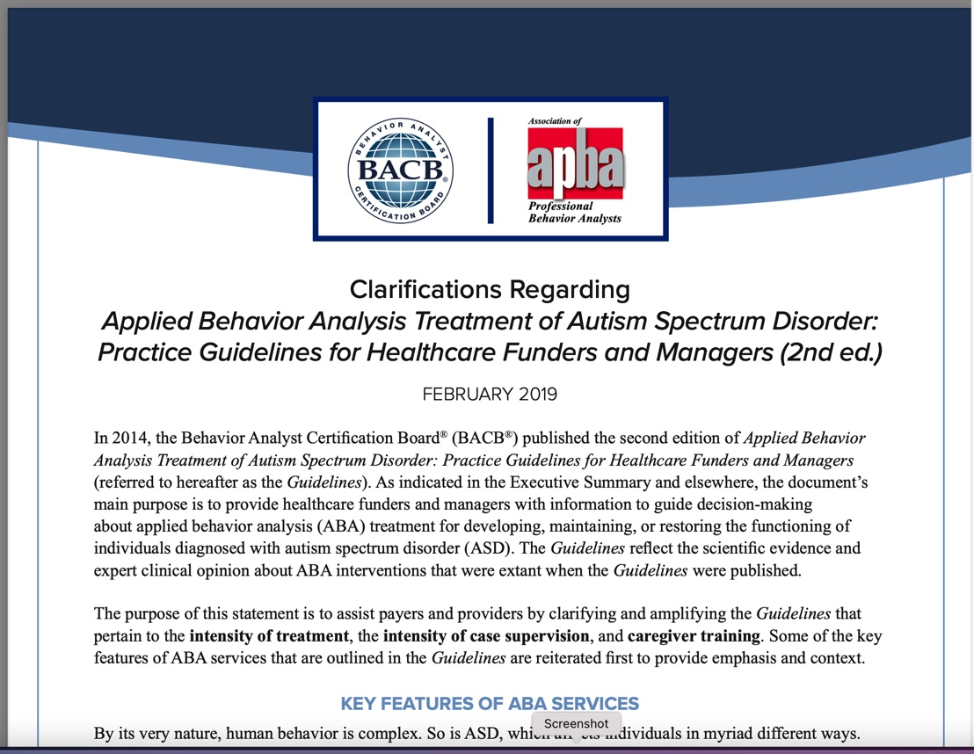

Slide 27
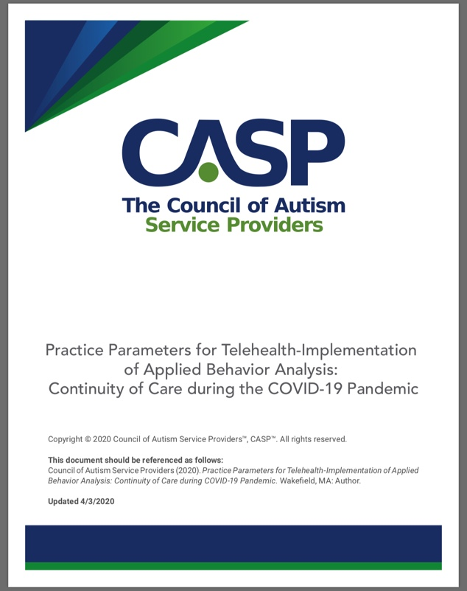

Slide 28
